Slide 1

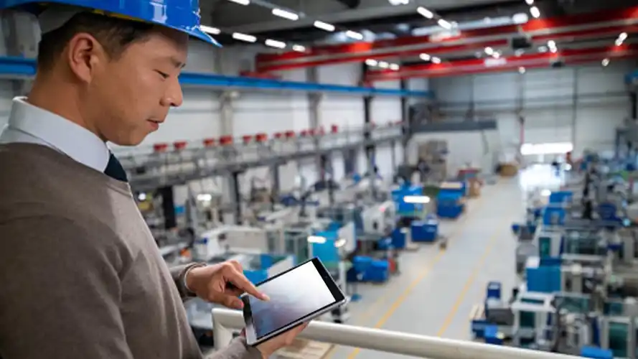
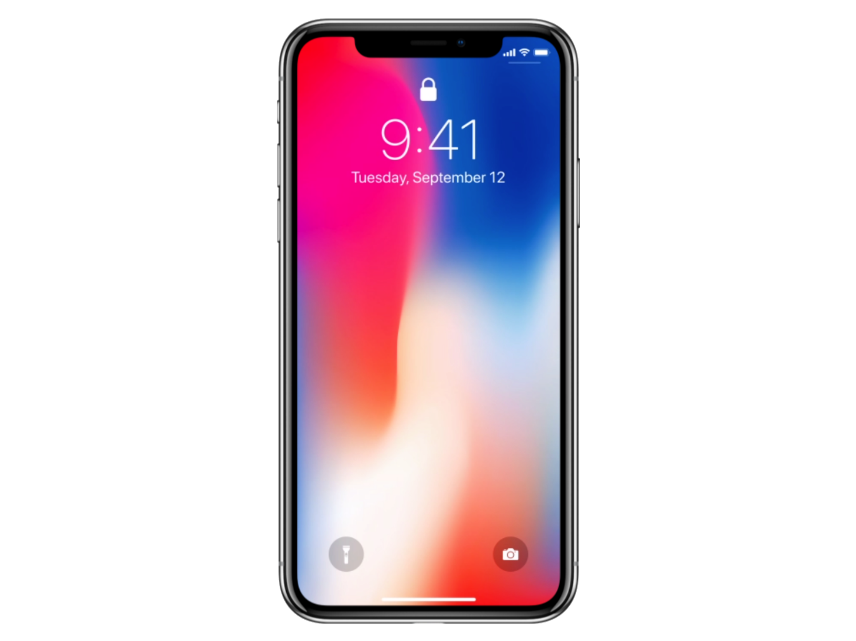
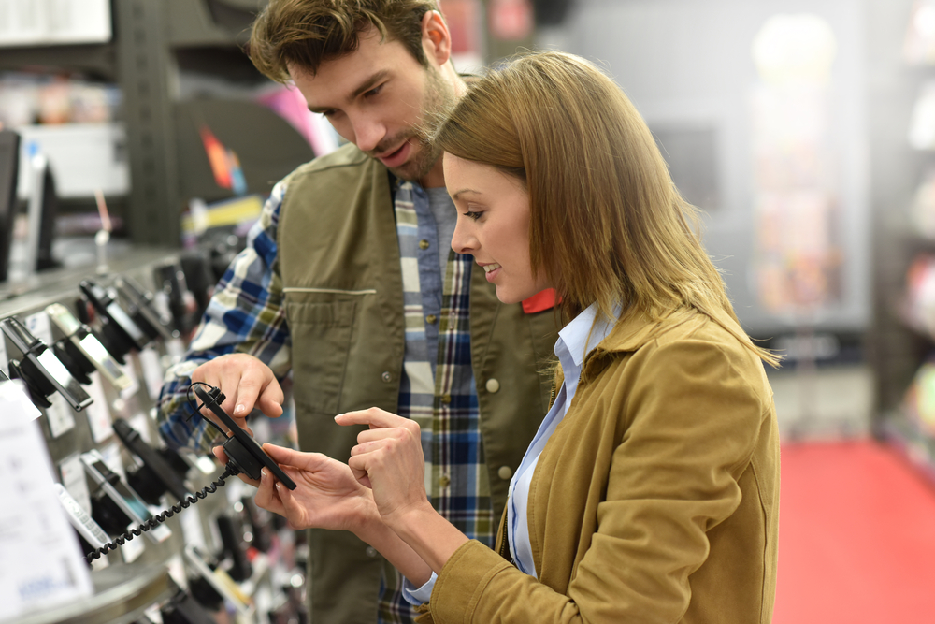
A Fake Product Identıfıcatıon System
CHECK PRODUCT(QR)
SET SERIAL KEY(QR)
MANUFACTURER
FAKE/REAL(QR)
FAKE/REAL(QR)
SELLER
Developed by Enes KILIÇ, Cihan DİKKAYA

Slide 2
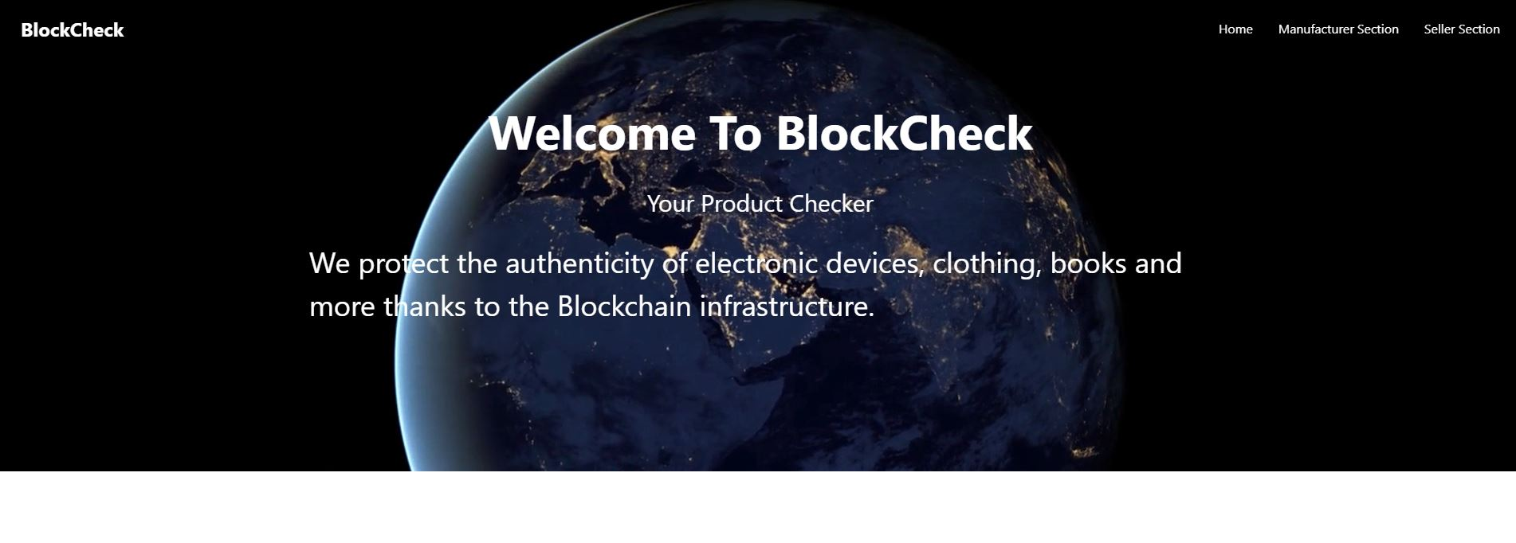
Welcome to blockeck

Slide 3
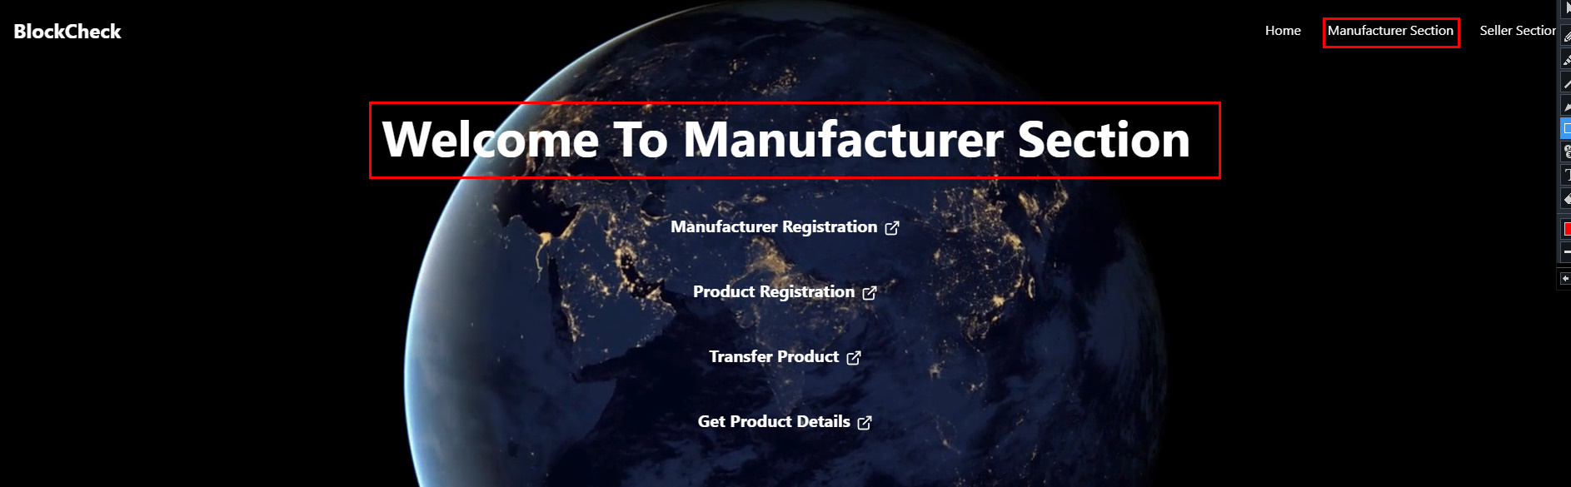
MANUFACTURER SECTION

Slide 4
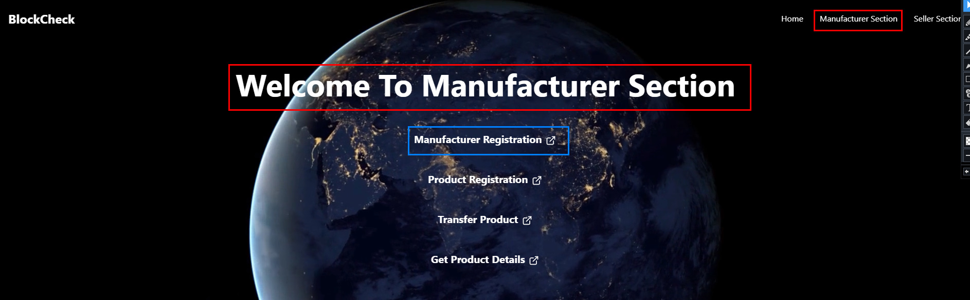
MANUFACTURER regıstratıon

Slide 5
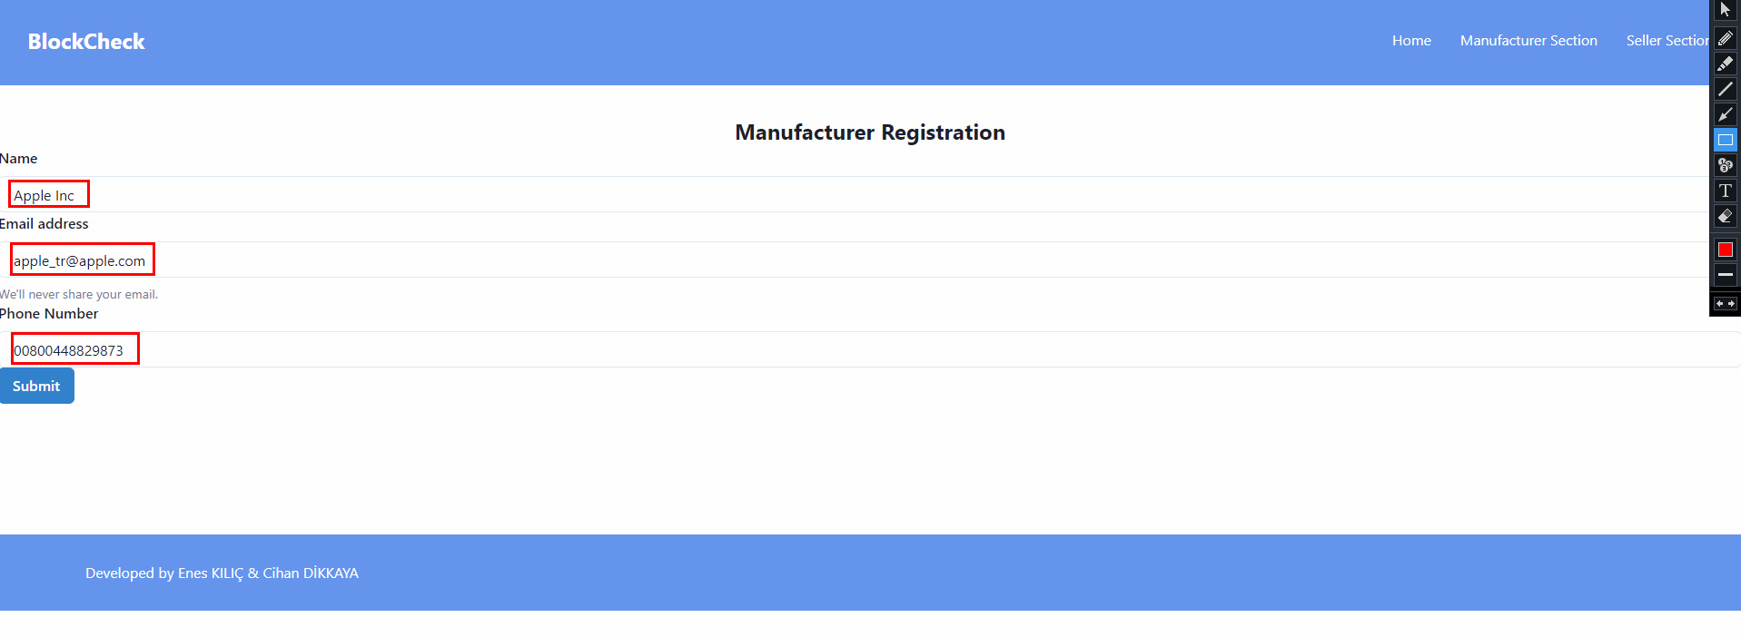
MANUFACTURER REGISTRATION

Slide 6
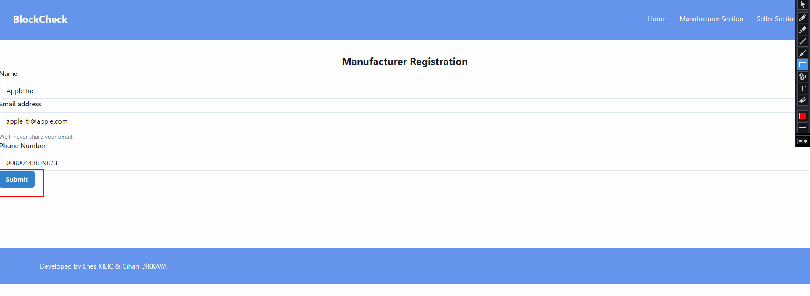
MANUFACTURER REGISTRATION(..)

Slide 7
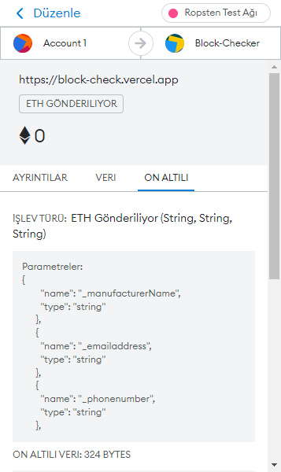

Slide 8
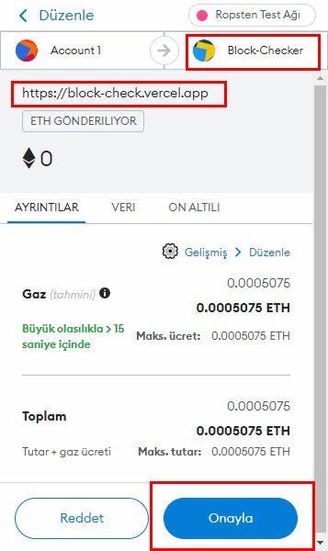

Slide 9
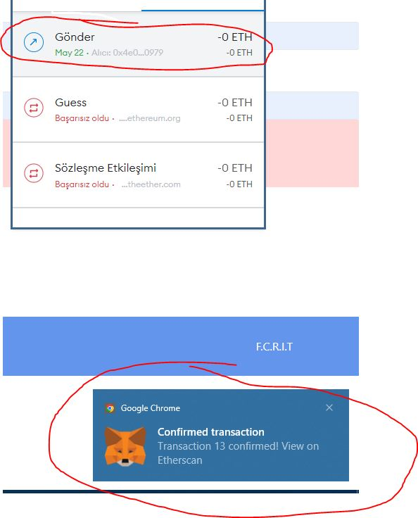

Slide 10
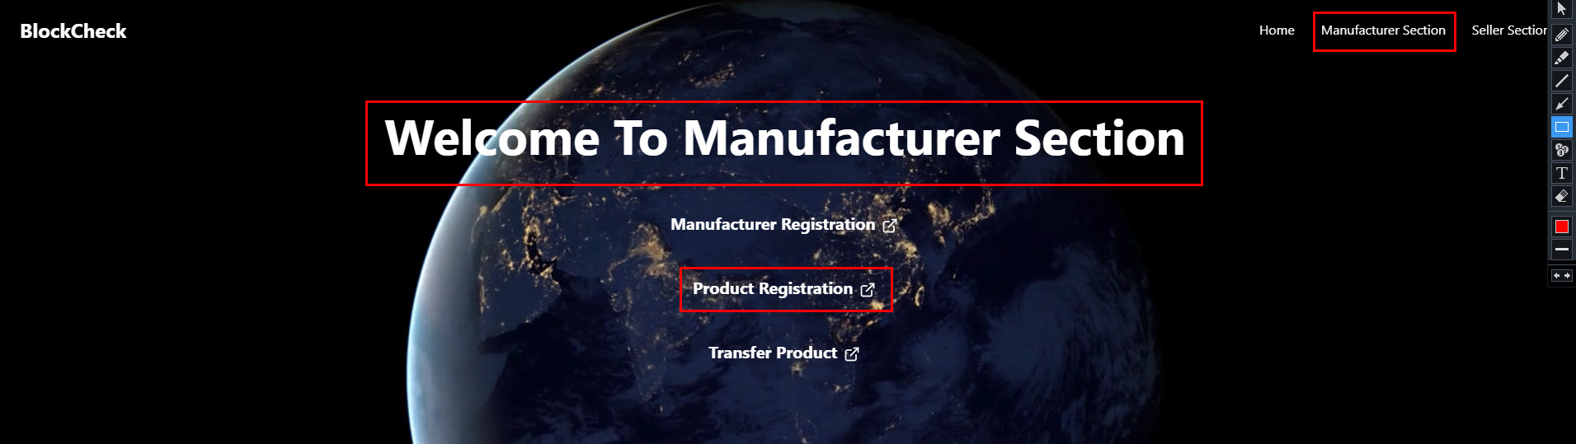
PRODUCT REGISTRATION

Slide 11
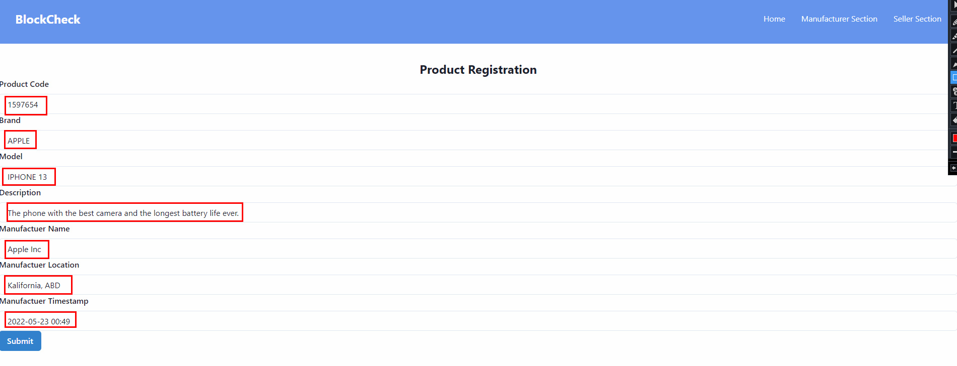
PRODUCT REGISTRATION

Slide 12
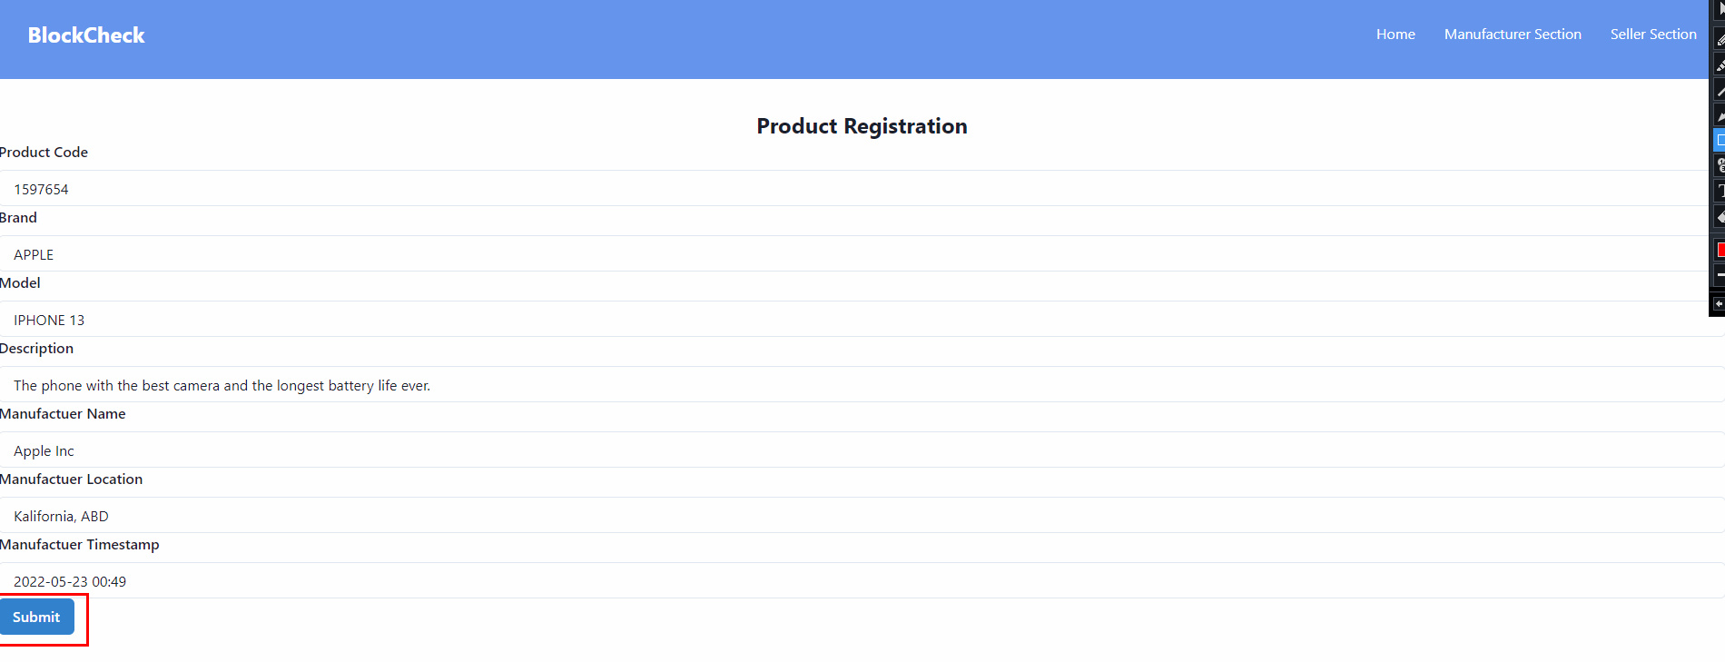
PRODUCT REGISTRATION

Slide 13
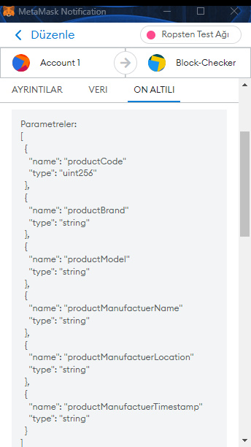

Slide 14
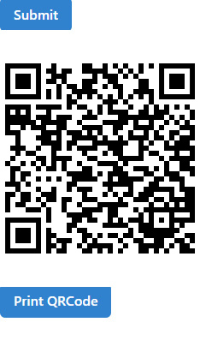
The QR CODE of the product with 1597654 product(ıphone 13) codes encrypted with Blockchain

Slide 15
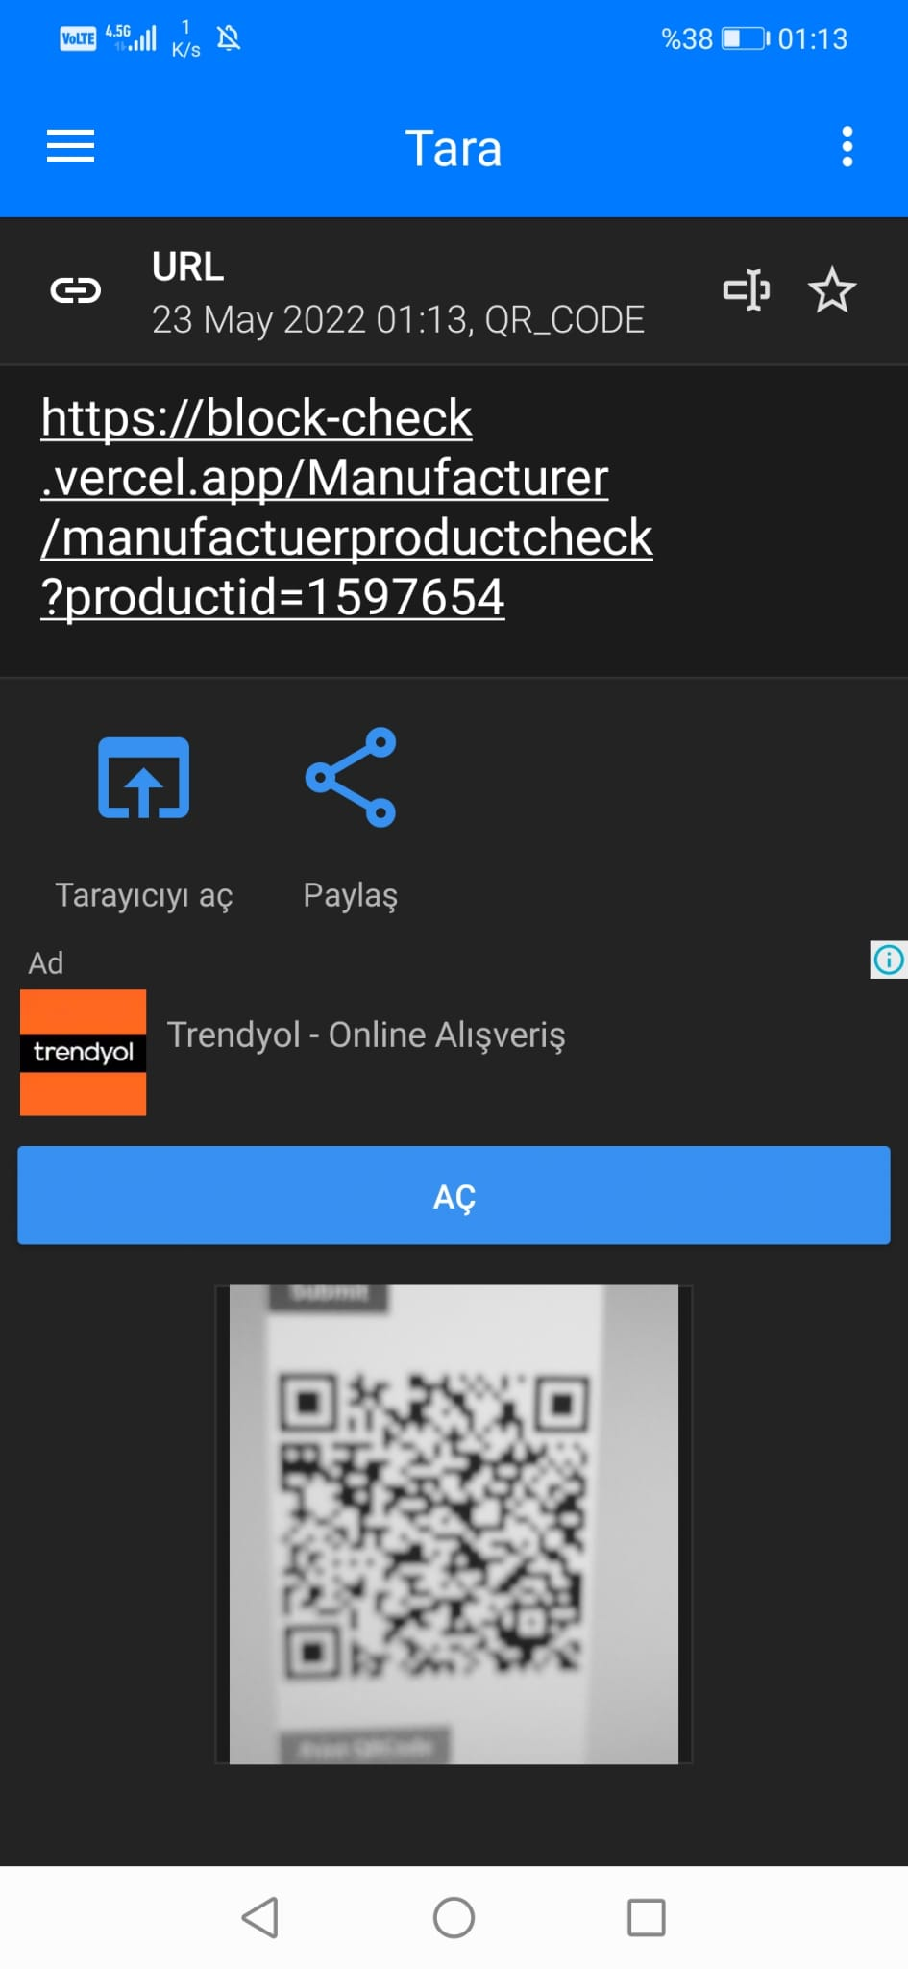
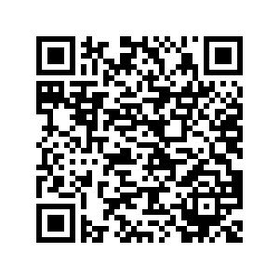
manufactuer Scanned QR Code

Slide 16
Manufacturer product ID query (Real/Fake)

Slide 17
manufactuer SCANNED THE FAKE PRODUCT

Slide 18
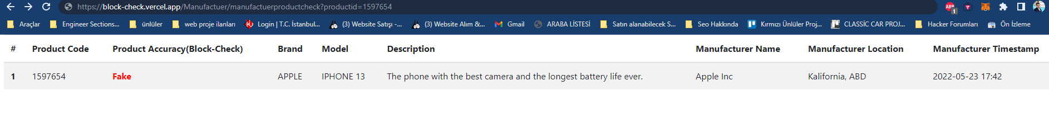
Manufacturer product ID query (Real/Fake)

Slide 19
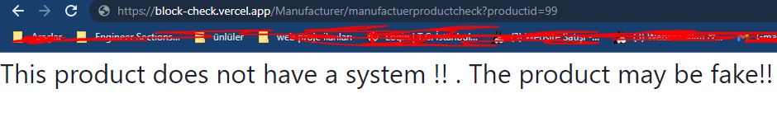
FAKE Product Testing

Slide 20
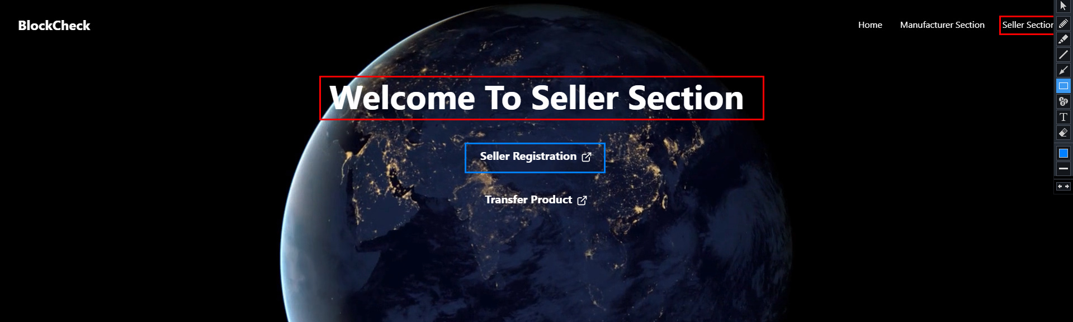
Seller sectıon

Slide 21
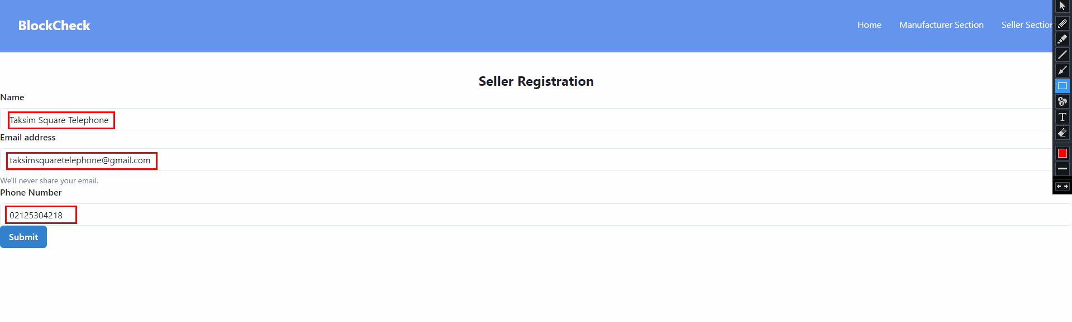
Seller regıstratıon

Slide 22
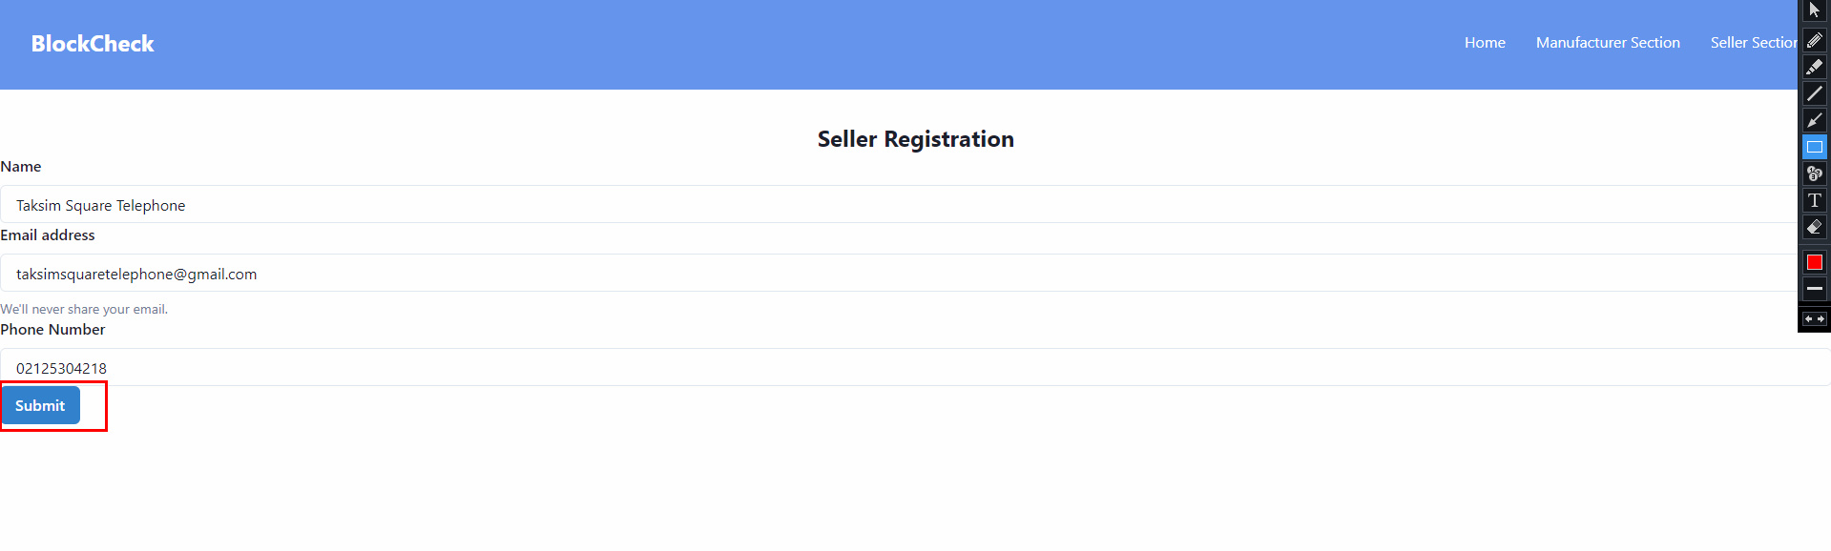
Seller regıstratıon

Slide 23
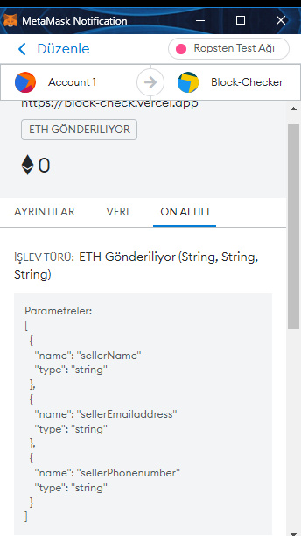
Metamask notıfıcatıon

Slide 24
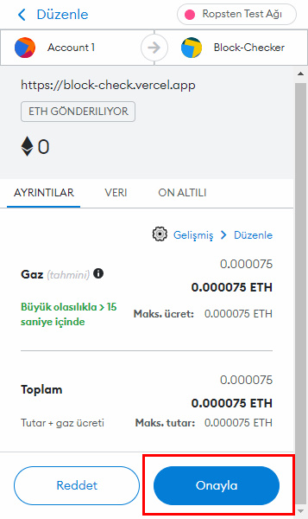
Metamask notıfıcatıon

Slide 25
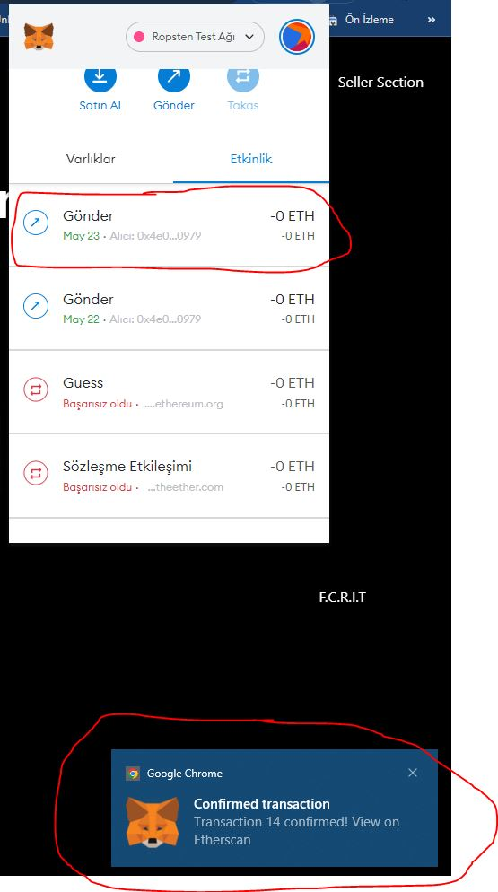
Confırmed transactıon

Slide 26
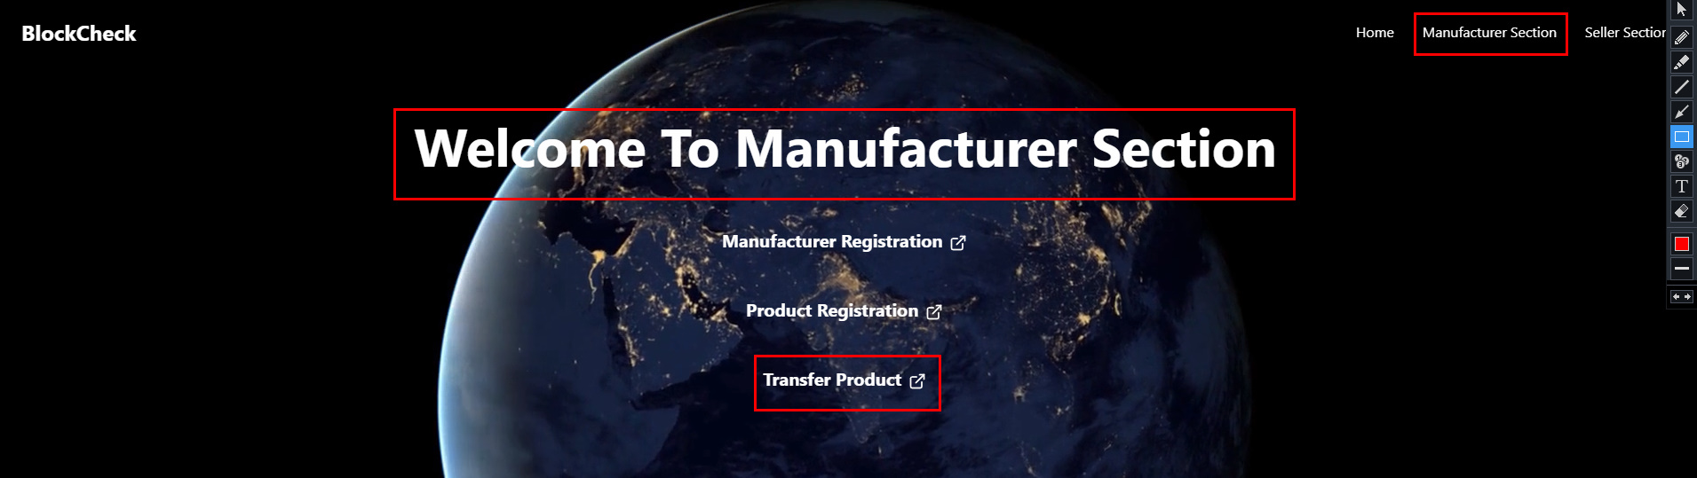
Transfer product

Slide 27
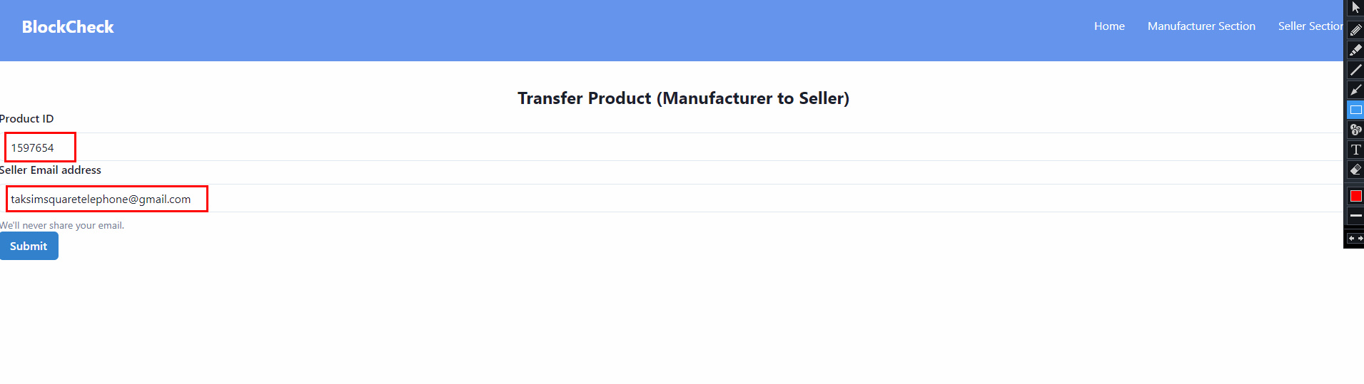
Transfer product(manufacturer TO SELLER)

Slide 28
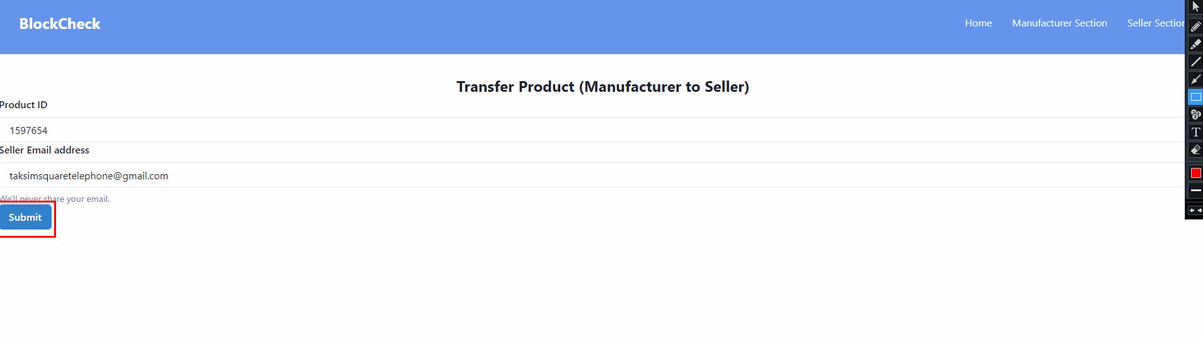
Transfer product(manufacturer TO SELLER)…

Slide 29
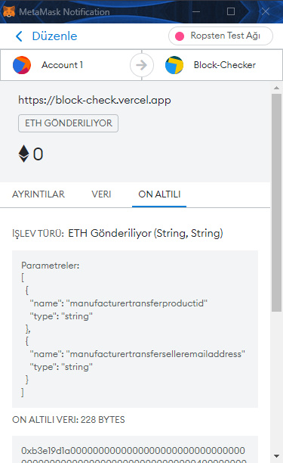
METAMASK NOTIFICATION

Slide 30
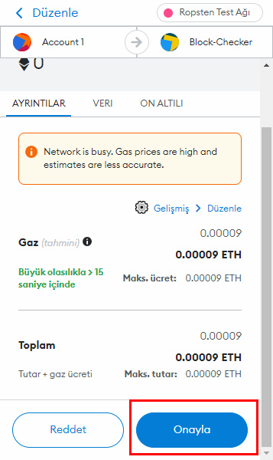
METAMASK NOTIFICATION(submıt)

Slide 31
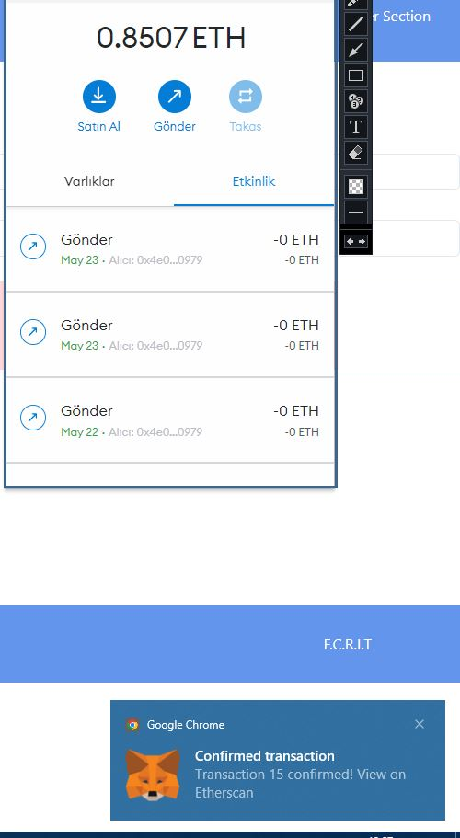
Confırmed transactıon

Slide 32
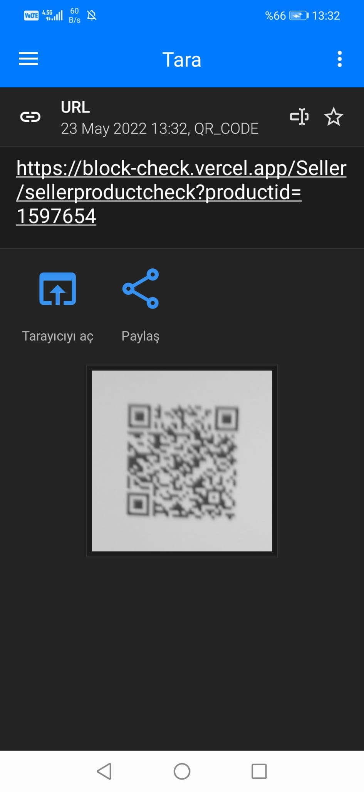
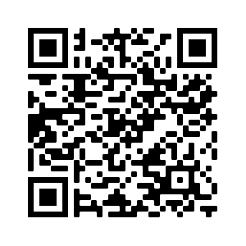
Seller scanned the qr code

Slide 33
seller product ID query (Real/Fake)

Slide 34
seller scanned the qr code

Slide 35
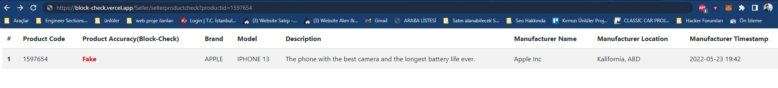
seller product ID query (Real/Fake)

Slide 36
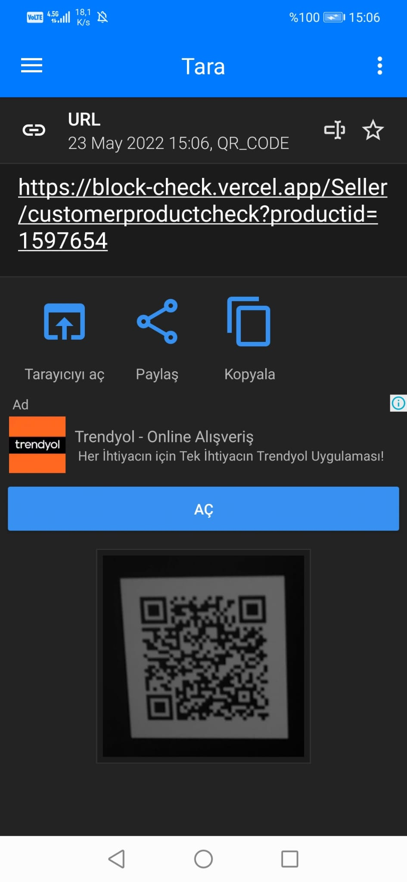
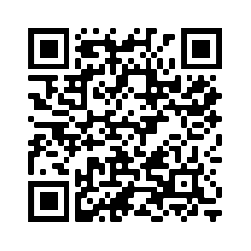
customer scanned the qr code

Slide 37
customer product ID query (Real/Fake)

Slide 38
customer scanned the qr code

Slide 39
customer product ID query (Real/Fake)

Slide 40
Thank you
CHECK PRODUCT(QR)
SET SERIAL KEY(QR)
MANUFACTURER
FAKE/REAL(QR)
FAKE/REAL(QR)
SELLER
Developed by Enes KILIÇ, Cihan DİKKAYA

